Slide 1



AngularJS 1 - Flow of Control & Filters
Mark J. Buckler
OCPJP,CIWJS

Slide 2

Credits
Some of the contents of this slide presentation have been referenced and reproduced, from Learning AngularJS 1, by Ray Villalobos, ©2018 LinkedIn Corporation.

Slide 3
LEARNING OBJECTIVES
Conditionals And Loops
AngularJS Services
Basic Content Filters
Advanced Filters
Enhanced Sorting

Slide 4
Conditionals And Loops
Conditional and Looping Directives
ng-show and ng-hide display an element dependent upon the value of a conditional
The element still exists in the DOM
Both elements use classes to show or hide the element, this process is called injection
ng-if acts based upon the value of a conditional
Element does not exist in the in the DOM unless the conditional is true
Can either create or destroy an element
ng-repeat
Enables the ability to loop through arrays or objects

Slide 5

Conditionals And Loops
Programming Exercise04_02_01 – Step 1
Implementing Conditionals and Loops

Slide 6
AngularJS Services
Services
AngularJS provides a number of services
$http Service
One of the most important services provided with AngularJS
Allows the handling of AJAX requests
Obviously requires a server, which we have running through Gulp in this project
AJAX is asynchronous, so AngularJS covers this with Promises

Slide 7
AngularJS Services
Programming Exercise04_02_01 – Step 2
Using the $http Service to Read a JSON file

Slide 8
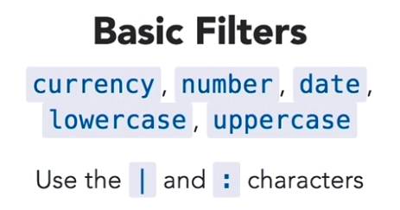
Basic Content Filters
Filters
Filters are used to modify content
Some are simple transformations for text
Other filters are more complex, designed to filter lists or arrays

Slide 9
Basic Content Filters
Programming Exercise04_02_01 – Step 3
Using Basic Filters

Slide 10
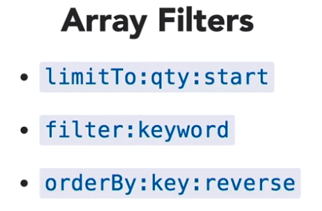
Advanced Filters
Array Filters
The first one limits the number of elements
Useful for things like pagination
Second one filters by keyword, good for searches
The third one controls sort order, based on a key, ascending or descending

Slide 11
Advanced Filters
Programming Exercise04_02_01 – Step 4
Using Advanced Filters

Slide 12
Enhanced Sorting
Programming Exercise04_02_01 – Step 5
Enhancing the GUI for Sorting

